Slide 1
Module8 Unit1
Is it a monster?

Slide 2
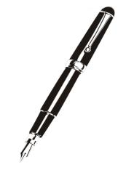

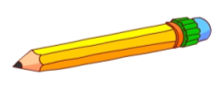

What’s this?
It’s a ____.
pen
Pencil.
It’s a _______
It’s a _______
book.
It’s a _________.
schoolbag

Slide 3
What’s this?
It’s a ____
Kite.
five
fine
hi

Slide 4
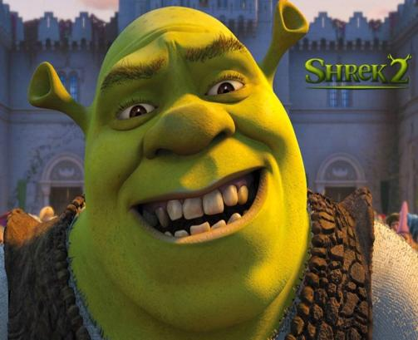
What’s this?
It’s a
monster.
怪物

Slide 5
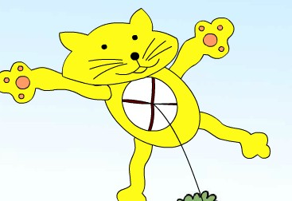
Is it a …?
No, it isn’t.
﹖
a cat or a kite?
或者
It’s a cat kite.

Slide 6
Listen and answer the questions.
Is it a cat?
No, it isn’t.
Is it a dog?
No, it isn’t.
Is it a monster?
No, it isn’t.
Is it a kite?
Yes, it is.
Notes:
PPT模板：www.1ppt.com/moban/ PPT素材：www.1ppt.com/sucai/
PPT背景：www.1ppt.com/beijing/ PPT图表：www.1ppt.com/tubiao/
PPT下载：www.1ppt.com/xiazai/ PPT教程： www.1ppt.com/powerpoint/
资料下载：www.1ppt.com/ziliao/ 范文下载：www.1ppt.com/fanwen/
试卷下载：www.1ppt.com/shiti/ 教案下载：www.1ppt.com/jiaoan/
PPT论坛：www.1ppt.cn PPT课件：www.1ppt.com/kejian/
语文课件：www.1ppt.com/kejian/yuwen/ 数学课件：www.1ppt.com/kejian/shuxue/
英语课件：www.1ppt.com/kejian/yingyu/ 美术课件：www.1ppt.com/kejian/meishu/
科学课件：www.1ppt.com/kejian/kexue/ 物理课件：www.1ppt.com/kejian/wuli/
化学课件：www.1ppt.com/kejian/huaxue/ 生物课件：www.1ppt.com/kejian/shengwu/
地理课件：www.1ppt.com/kejian/dili/ 历史课件：www.1ppt.com/kejian/lishi/

Slide 7


I don’t know.
我不知道。
PPT模板：www.1ppt.com/moban/ PPT素材：www.1ppt.com/sucai/
PPT背景：www.1ppt.com/beijing/ PPT图表：www.1ppt.com/tubiao/
PPT下载：www.1ppt.com/xiazai/ PPT教程： www.1ppt.com/powerpoint/
资料下载：www.1ppt.com/ziliao/ 范文下载：www.1ppt.com/fanwen/
试卷下载：www.1ppt.com/shiti/ 教案下载：www.1ppt.com/jiaoan/
PPT论坛：www.1ppt.cn PPT课件：www.1ppt.com/kejian/
语文课件：www.1ppt.com/kejian/yuwen/ 数学课件：www.1ppt.com/kejian/shuxue/
英语课件：www.1ppt.com/kejian/yingyu/ 美术课件：www.1ppt.com/kejian/meishu/
科学课件：www.1ppt.com/kejian/kexue/ 物理课件：www.1ppt.com/kejian/wuli/
化学课件：www.1ppt.com/kejian/huaxue/ 生物课件：www.1ppt.com/kejian/shengwu/
地理课件：www.1ppt.com/kejian/dili/ 历史课件：www.1ppt.com/kejian/lishi/

Slide 8

help

Slide 9
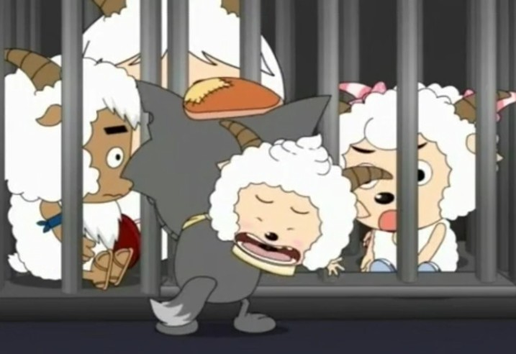
Help!

Slide 10
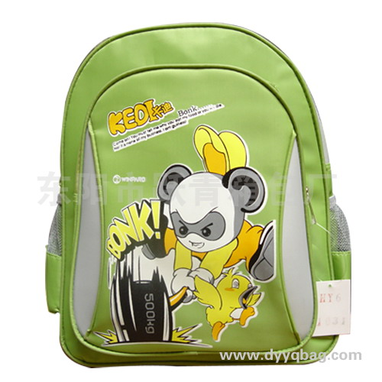
Is it a_______?
﹖
schoolbag
Yes, it is.

Slide 11
bird
Is it a ?
Yes, it is.

Slide 12
dog
Is it a ?
Yes, it is.

Slide 13

Is it a _____?
bird

Slide 14
book
Is it a ?
Yes, it is.

Slide 15

Is it a _____?
bird

Slide 16
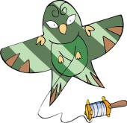
It’s a kite.
No, it isn’t.

Slide 17
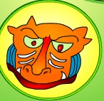
Is it a … ?
cat
No, it isn’t.
﹖
It’s a monster.

Slide 18
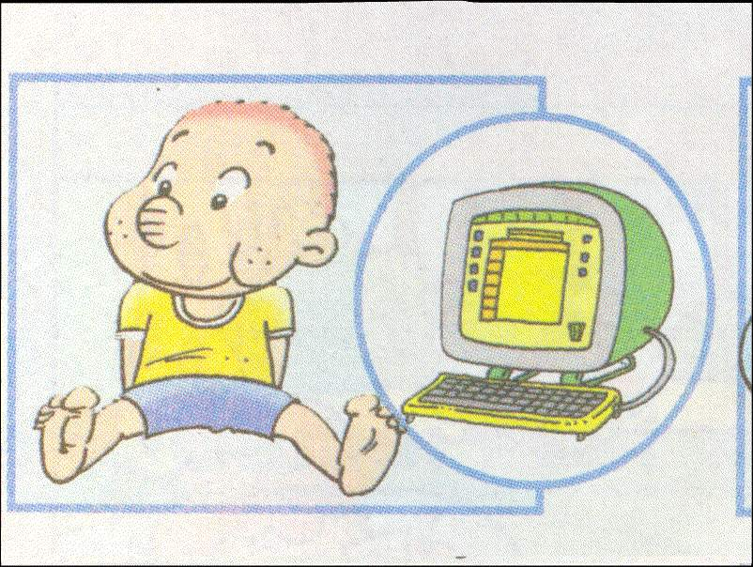

Sam got a present on his birthday.
Do you know what it is ?

Slide 19
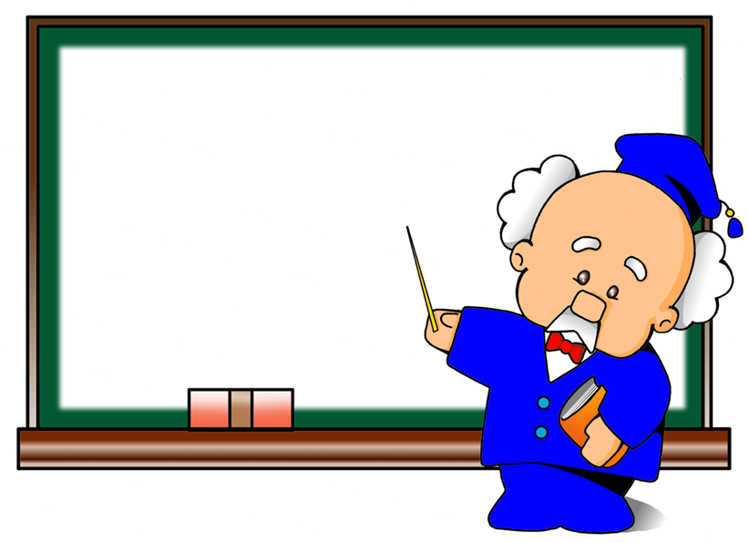


Guess
No, it isn’t.
No, it isn’t .
It’s a book.

Slide 20
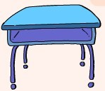
Is it a chair?
No, it isn’t.
It’s a desk.

Slide 21

Is it a window?
Yes, it is.

Slide 22
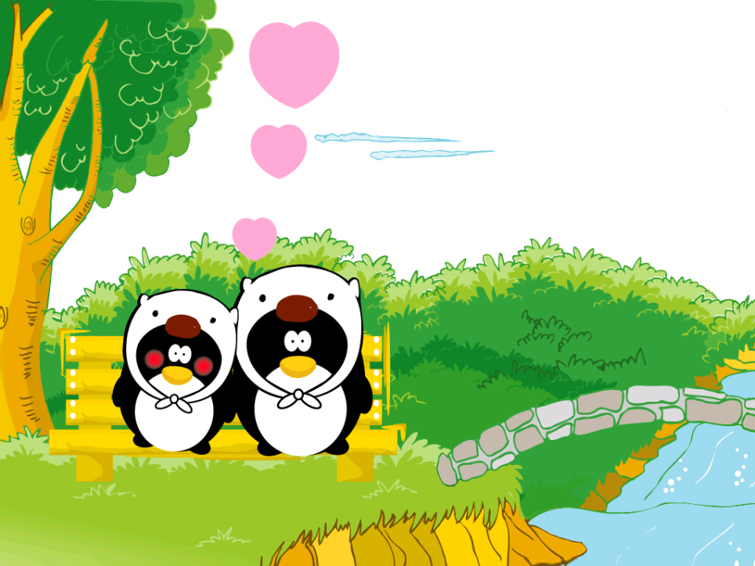


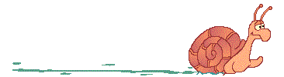
Thank you!
Byebye!

